Slide 1




Distance vector
Routing Protocols
Router and Routing Basics
Version 3.0
Cisco Regional Networking Academy

Slide 2
Objectives
Describe how routing loops can occur in distance vector routing
Describe several methods used by distance vector routing protocols to ensure that routing information is accurate
Configure RIP
Use the ip classless command
Troubleshoot RIP
Configure RIP for load balancing
Configure static routes for RIP
Verify RIP
Configure IGRP
Verify IGRP operation, troubleshoot IGRP

Slide 3
Table of Content
1 | Distance Vector Routing
2 | RIP
3 | IGRP

Slide 4

DISTANCE VECTOR ROUTING

Slide 5
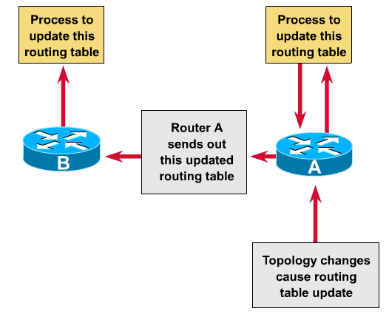
Distance vector routing updates
Notes:
Routing table updates occur periodically or when the topology in a distance vector protocol network changes. It is important that a routing protocol be efficient in updating the routing tables. As with the network discovery process, topology change updates proceed systematically from router to router. Distance vector algorithms call for each router to send its entire routing table to each of its adjacent neighbors. The routing tables include information about the total path cost as defined by the metrics and the logical address of the first router on the path to each network contained:
Bandwidth
Delay
Hop count
Load
Reliability
MTU

Slide 6
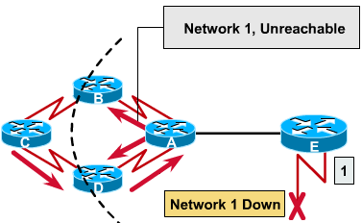
Distance vector routing loop issues
Notes:
Routing loops can occur when inconsistent routing tables are not updated due to slow convergence in a changing network.
Just before the failure of Network 1, all routers have consistent knowledge and correct routing tables. The network is said to have converged. Assume for the remainder of this example that Router C's preferred path to Network 1 is by way of Router B, and the distance from Router C to Network 1 is 3.
When Network 1 fails, Router E sends an update to Router A. Router A stops routing packets to Network 1, but Routers B, C, and D continue to do so because they have not yet been informed of the failure. When Router A sends out its update, Routers B and D stop routing to Network 1. However, Router C has not received an update. To Router C, Network 1 is still reachable via Router B.
Now Router C sends a periodic update to Router D, indicating a path to Network 1 by way of Router B. Router D changes its routing table to reflect this good, but incorrect, information, and propagates the information to Router A. Router A propagates the information to Routers B and E, and so on. Any packet destined for Network 1 will now loop from Router C to B to A to D and back to again to C.

Slide 7
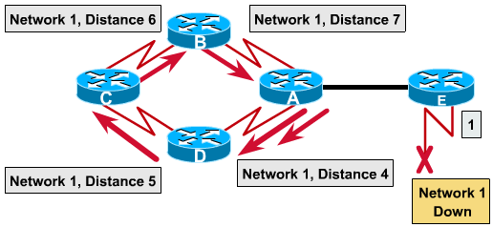
The Problem of Count to infinity
Routing loops increment the distance vector
Notes:
The invalid updates of Network 1 will continue to loop until some other process stops the looping. This condition, called count to infinity, loops packets continuously around the network in spite of the fundamental fact that the destination network, Network 1, is down. While the routers are counting to infinity, the invalid information allows a routing loop to exist.
Without countermeasures to stop the count to infinity process, the distance vector metric of hop count increments each time the packet passes through another router. These packets loop through the network because of wrong information in the routing tables.

Slide 8
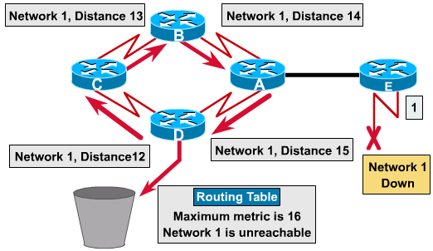
Defining a maximum count
Specific a maximum distance vector metric as infinity.
Notes:
Distance vector routing algorithms are self-correcting, but a routing loop problem can require a count to infinity. To avoid this prolonged problem, distance vector protocols define infinity as a specific maximum number. This number refers to a routing metric which may simply be the hop count.
With this approach, the routing protocol permits the routing loop to continue until the metric exceeds its maximum allowed value. The graphic shows the metric value as 16 hops. This exceeds the distance vector default maximum of 15 hops so the packet is discarded by the router. In any case, when the metric value exceeds the maximum value, Network 1 is considered unreachable.

Slide 9
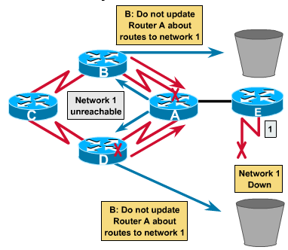
Elimination routing loops through split horizon
Advertises routes out an interface only if they were not learned from updates entering that interface.
Notes:
Another possible source for a routing loop occurs when incorrect information that has been sent back to a router contradicts the correct information that the router originally distributed. Here is how this problem occurs:
Router A passes an update to Router B and Router D, indicating that Network 1 is down. Router C, however, transmits an update to Router B, indicating that Network 1 is available at a distance of 4, by way of Router D. This does not violate split-horizon rules.
Router B concludes, incorrectly, that Router C still has a valid path to Network 1, although at a much less favorable metric. Router B sends an update to Router A advising Router A of the new route to Network 1.
Router A now determines that it can send to Network 1 by way of Router B; Router B determines that it can send to Network 1 by way of Router C; and Router C determines that it can send to Network 1 by way of Router D. Any packet introduced into this environment will loop between routers.
Split-horizon attempts to avoid this situation. If a routing update about Network 1 arrives from Router A, Router B or Router D cannot send information about Network 1 back to Router A. Split-horizon thus reduces incorrect routing information and reduces routing overhead

Slide 10
Route poisoning
Network 3
Network 4
Network 5
A
B
C
E
Network 1 Distance 16
D
When Network 5 goes down, Router E initiates route poisoning by making a table entry for Network 5 as 16, or unreachable.
When route poisoning is used with triggered updates it will speed up convergence time.
Notes:
Route poisoning is used by various distance vector protocols in order to overcome large routing loops and offer explicit information when a subnet or network is not accessible. This is usually accomplished by setting the hop count to one more than the maximum.
One way to avoid inconsistent updates is route poisoning. When Network 5 goes down, Router E initiates route poisoning by making a table entry for Network 5 as 16, or unreachable. By this poisoning of the route to Network 5, Router C is not susceptible to incorrect updates about the route to Network 5. When Router C receives a router poisoning from Router E, it sends an update, called a poison reverse, back to Router E. This makes sure all routes on the segment have received the poisoned route information.
When route poisoning is used with triggered updates it will speed up convergence time because neighboring routers do not have to wait 30 seconds before advertising the poisoned route.
Route poisoning causes a routing protocol to advertise infinite-metric routes for a failed route. Route poisoning does not break split horizon rules. Split horizon with poison reverse is essentially route poisoning, but specifically placed on links that split horizon would not normally allow routing information to flow across. In either case, the result is that failed routes are advertised with infinite metrics.

Slide 11
Split horizon with poison reverse
Network 3
Network 4
Network 5
A
B
C
E
Network 1 Distance 16
Network 1 unreachable
D
Route poisoning does not break split horizon rules.
Split horizon with poison reverse is essentially route poisoning, but specifically placed on links that split horizon would not normally allow routing information to flow across, the failed routes are advertised with infinite metrics.
Notes:
Route poisoning causes a routing protocol to advertise infinite-metric routes for a failed route. Route poisoning does not break split horizon rules. Split horizon with poison reverse is essentially route poisoning, but specifically placed on links that split horizon would not normally allow routing information to flow across. In either case, the result is that failed routes are advertised with infinite metrics.

Slide 12
Avoiding routing loops with triggered updates
Network 10.4.0.0 is unreachable
10.1.0.0
10.2.0.0
10.3.0.0
10.4.0.0
A
B
C
With the triggered update approach, routers send messages as soon as they notify a change in their routing table
Notes:
New routing tables are sent to neighboring routers on a regular basis. For example, RIP updates occur every 30 seconds. However a triggered update is sent immediately in response to some change in the routing table. The router that detects a topology change immediately sends an update message to adjacent routers that, in turn, generate triggered updates notifying their adjacent neighbors of the change. When a route fails, an update is sent immediately rather than waiting on the update timer to expire. Triggered updates, used in conjunction with route poisoning, ensure that all routers know of failed routes before any holddown timers can expire. Triggered updates go ahead and send updates because routing information has changed not waiting for the timer to expire. The router sends another routing update on its other interfaces rather than waiting on the routing update timer to expire. This causes the information about the status of the route that has changed, to be forwarded and starts the holddown timers more rapidly on the neighboring routers. The wave of updates propagates throughout the network.
Issuing a triggered update Router C announces that network 10.4.0.0 is unreachable. Upon receipt of this information, Router B announces through interface S0/1 that network 10.4.0.0 is down. In turn, Router A sends an update out interface Fa0/0.

Slide 13
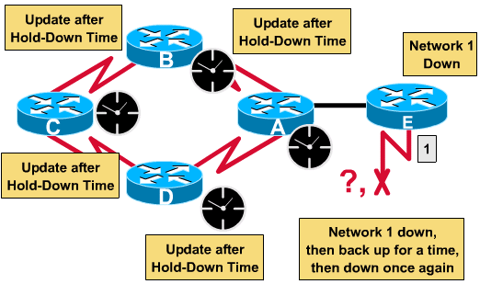
Preventing routing loops with holddown timers
Notes:
A count to infinity problem can be avoided by using holddown timers:
When a router receives an update from a neighbor indicating that a previously accessible network is now inaccessible, the router marks the route as inaccessible and starts a hold-down timer.
If at any time during hold-down timer an update is received from
The same neighbor indicating that the network is again accessible, the router marks the network as accessible and removes the hold-down timer.
A different neighboring router with a better metric than originally recorded for the network, the router marks the network as accessible and removes the hold-down timer.
A different neighboring router with a poorer metric, the update is ignored.

Slide 14
RIP
ROUTING INFORMATION PROTOCOL

Slide 15
RIP routing process
It is a distance-vector routing protocol. RFC 1058.
Hop count is used as the metric for path selection.
If the hop count is greater than 15, the packet will be discarded.
By default, routing updates are broadcast every 30 seconds.
RIP has evolved over the years from a Classful Routing Protocol, RIP Version 1 (RIP v1), to a Classless Routing Protocol, RIP Version 2 (RIP v2). RIP v2 enhancements include:
  Ability to carry additional packet routing information.
  Authentication mechanism to secure table updates.
  Supports variable length subnet masking (VLSM).
Notes:
The modern open standard version of RIP, sometimes referred to as IP RIP, is formally detailed in two separate documents. The first is known as Request for Comments (RFC) 1058 and the other as Internet Standard (STD) 56.
RIP has evolved over the years from a Classful Routing Protocol, RIP Version 1 (RIP v1), to a Classless Routing Protocol, RIP Version 2 (RIP v2). RIP v2 enhancements include:
Ability to carry additional packet routing information.
Authentication mechanism to secure table updates.
Supports variable length subnet masking (VLSM).
RIP prevents routing loops from continuing indefinitely by implementing a limit on the number of hops allowed in a path from the source to a destination. The maximum number of hops in a path is 15. When a router receives a routing update that contains a new or changed entry, the metric value is increased by 1 to account for itself as a hop in the path. If this causes the metric to be incremented beyond 15, it is considered to be infinity and the network destination is considered unreachable. RIP includes a number of features that are common in other routing protocols. For example, RIP implements split horizon and holddown mechanisms to prevent incorrect routing information from being propagated.

Slide 16
Basic Configuring RIP
Ethernet
Ethernet
F0/0
S0/1
S0/0
S0/0
F0/0
BHM
GAD
BOAZ
10.0.0.254
192.168.13.1
192.168.13.2
192.168.14.2
192.168.14.2
172.31.31.1
BHM(config)#router rip
BHM(config-router)#network 10.0.0.0 BHM(config-router)#network 192.168.13.0
Selects RIP as the routing protocol
Specifies a directly connected network
Major netwotk not subbnetwork
GAD(config)#router rip
GAD(config-router)#network 192.168.14.0 GAD(config-router)#network 192.168.13.0
BOAZ(config)#router rip
BOAZ(config-router)#network 192.168.14.0 BOAZ(config-router)#network 172.31.0.0
BHM(config)#interface s0/0
BHM(config-if)#ip rip triggered
Notes:
The router rip command enables RIP as the routing protocol.
The network command is then used to tell the router on which interfaces to run RIP. The routing process then associates specific interfaces with the network addresses and begins sending and receiving RIP updates on these interfaces.
RIP sends routing-update messages at regular intervals. When a router receives a routing update that includes changes to an entry, it updates its routing table to reflect the new route. The received metric value for the path is increased by 1, and the source interface of the update is indicated as the next hop in the routing table. RIP routers maintain only the best route to a destination but can maintain multiple equal-cost paths to the destination.
For example, the descriptions for the commands used to configure router BHM shown in the figure are as follows:
BHM(config)#router rip – Selects RIP as the routing protocol
BHM(config-router)#network 10.0.0.0 – Specifies a directly connected network
BHM(config-router)#network 192.168.13.0 – Specifies a directly connected network
The Cisco router interfaces that are connected to networks 10.0.0.0 and 192.168.13.0 send and receive RIP updates. These routing updates allow the router to learn the network topology from neighboring router also running RIP.
To enable RIP, use the following commands beginning in global configuration mode:
Router(config)#router rip – Enables the RIP routing process
Router(config-router)#network network-number – Associates a network with the RIP routing process
A router running RIP can be configured to send a triggered update when the network topology changes using the ip rip triggered command. This command is issued only on serial interfaces at the router(config-if)# prompt. After updating its routing table due to a configuration change, the router immediately begins transmitting routing updates in order to inform other network routers of the change. These updates, called triggered updates, are sent independently of the regularly scheduled updates that RIP routers forward.

Slide 17
Configuring RIP: Option tasks
Applying offsets to routing metrics
Adjusting timers
Specifying a RIP version
Enabling RIP authentication
Configuring route summarization on an interface
Verifying IP route summarization
Disabling automatic route summarization
Running IGRP and RIP concurrently
Disabling the validation of source IP addresses
Enabling or disabling split horizon
Connecting RIP to a WAN
Notes:
RIP must be enabled and the networks specified. The remaining tasks are optional. Among these optional tasks are:
Applying offsets to routing metrics
Adjusting timers
Specifying a RIP version
Enabling RIP authentication
Configuring route summarization on an interface
Verifying IP route summarization
Disabling automatic route summarization
Running IGRP and RIP concurrently
Disabling the validation of source IP addresses
Enabling or disabling split horizon
Connecting RIP to a WAN

Slide 18
Without ip classless command
10.3.3.0
Fa0/1
192.168.1.4/30
S0/0
BHM
GAD
Fa0/0
192.168.13.2
10.1.1.0
To
10.2.2.4
Destination network | Outbound interface
10.3.3.0 | Fa0/1
10.1.1.0 | Fa0/0
0.0.0.0 | S0/0
Notes:
When ip classless feature is disabled (use no form of this command) any packets received that are destined for a subnet that numerically falls within the router’s subnetwork addressing scheme will be discarded.
IP classless only affects the operation of the forwarding processes in IOS. IP classless does not affect the way the routing table is built. This is the essence of classful routing. If one part of a major network is known, but the subnet toward which the packet is destined within that major network is unknown, the packet is dropped.
The most confusing aspect of this rule is that the router only uses the default route if the major network destination does not exist in the routing table. A router by default assumes that all subnets of a directly connected network should be present in the routing table. If a packet is received with an unknown destination address within an unknown subnet of a directly attached network, the router assumes that the subnet does not exist. So the router will drop the packet even if there is a default route.

Slide 19
With ip classless command
10.3.3.0
Fa0/1
192.168.1.4/30
S0/0
BHM
GAD
Fa0/0
192.168.13.2
10.1.1.0
To
10.2.2.4
Destination network | Outbound interface
10.3.3.0 | Fa0/1
10.1.1.0 | Fa0/0
0.0.0.0 | S0/0
Notes:
In order for the Cisco IOS software to forward these packets to the best supernet route possible, use the ip classless global configuration command. A supernet route is a route that covers a greater range of subnets with a single entry. For example, an enterprise uses the entire subnet 10.10.0.0 /16, then a supernet route for 10.10.10.0 /24 would be 10.10.0.0 /16. The ip classless command is enabled by default in Cisco IOS Software Release 11.3 and later. To disable this feature, use the no form of this command.
Configuring ip classless on the router resolves this problem by allowing the router to ignore the classful boundaries of the networks in its routing table and simply route to the default route.

Slide 20
Common RIP configuration issues
To reduce routing loops and counting to infinity, RIP uses the following techniques:
  Count-to-infinity
  Split horizon
  Poison reverse
  Holddown counters
  Triggered updates
Notes:
RIP routers must rely on neighboring routers for network information that is not known first hand. A common term used to describe this functionality is Routing By Rumor. RIP uses a distance vector routing algorithm. All distance vector routing protocols have issues that are primarily created by slow convergence. Convergence is when all routers in the same internetwork have the same routing information. Among these issues are routing loops and counting to infinity. These result in inconsistencies due to routing update messages with out of date routes being propagated around the internetwork.
To reduce routing loops and counting to infinity, RIP uses the following techniques:
Count-to-infinity
Split horizon
Poison reverse
Holddown counters
Triggered updates
Some of these methods may require some configuration, while others do not require or rarely require configuration.

Slide 21
Setting holddown timer
To disable split horizon:
Router(config-if)#no ip split-horizon
To change the holddown timer:
Router(config-router)#timers basic update invalid holddown flush [sleeptime]
To change the update internal:
Router(config-router)#update-timer seconds
Disable the sending of routing updates on specified interfaces:
Router(config-router)#passive-interface interface
Configure RIP in a non-broadcast network:
Router(config-router)#neighbor ip address
Notes:
RIP permits a maximum hop count of 15. Any destination greater that 15 hops away is tagged as unreachable. RIP’s maximum hop count greatly restricts its use in large internetworks but prevents a problem called “counting to infinity” from causing endless network routing loops.
The split horizon rule is based on the theory that it is not useful to send information about a route back in the direction from which it came. In some network configurations, it may be necessary to disable split horizon.
The following command is used to disable split horizon:
GAD(config-if)#no ip split-horizon
The holddown timer is another mechanism that may need some changes. Holddown timers help prevent counting to infinity but also increase convergence time. The default holddown for RIP is 180 seconds. This will prevent any inferior route from being updated but may also prevent a valid alternative route from being installed. The holddown timer can be decreased to speed up convergence but should be done with caution. The ideal setting would be to set the timer just longer that the longest possible update time for the internetwork. In the example in Figure , the loop consists of four routers. If each router has an update time of 30 seconds, the longest loop would be 120 seconds. Therefore, the holddown timer should be set to slightly more than 120 seconds.
To change the holddown timer:
Router(config-router)#timers basic update invalid holddown flush [sleeptime]
One additional item that affects convergence time, and is configurable, is the update interval. The default RIP update interval in Cisco IOS is 30 seconds. This can be configured for longer intervals to conserve bandwidth, or for shorter intervals to decrease convergence time.
To change the update internal:
GAD(config-router)#update-timer seconds
Another issue with routing protocols is the unwanted advertisement of routing updates out a particular interface. When a network command is issued for a given network, RIP will immediately begin sending advertisements out all interfaces within the specified network address range. To control the set of interfaces that will exchange routing updates, the network administrator can disable the sending of routing updates on specified interfaces by configuring the passive-interface command.
Because RIP is a broadcast protocol, the network administrator may have to configure RIP to exchange routing information in a non-broadcast network such as Frame Relay. In this type of network, RIP needs to be told of other neighboring RIP routers by configuring the neighbor ip address

Slide 22
To configure the router to send and receive packets
Command | Purpose
Router(config-router)#version {1 | 2} | Configure the software to send and receive RIP version 1 version 2 packets
Router(config-if)#ip rip send version 1 | Configure an interface to send RIP version 1 packets
Router(config-if)#ip rip send version 2 | Configure an interface to send RIP version 2 packets
Router(config-if)#ip rip send version 1 2 | Configure an interface to send RIP version 1 or 2 packets
Router(config-if)#ip rip receive version 1 | Configure an interface to receive RIP version 1 packets
Router(config-if)#ip rip receive version 2 | Configure an interface to receive RIP version 2 packets
Router(config-if)#ip rip receive version 1 2 | Configure an interface to receive RIP version 1 or 2 packets
Notes:
By default, the Cisco IOS software receives RIP Version 1 and Version 2 packets, but sends only Version 1 packets. The network administrator can configure the router to only receive and send Version 1 packets or the administrator can configure the router to send only Version 2 packets. To configure the router to send and receive packets from only one version

Slide 23
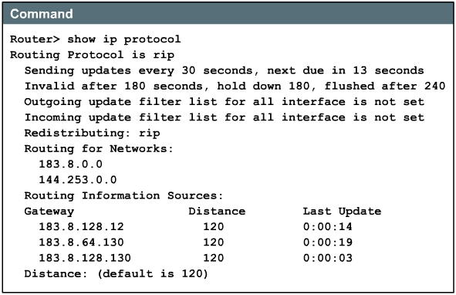
Verifying RIP configuration: SHOW IP PROTOCOLS
RIP interface
Networks being advertised

Slide 24
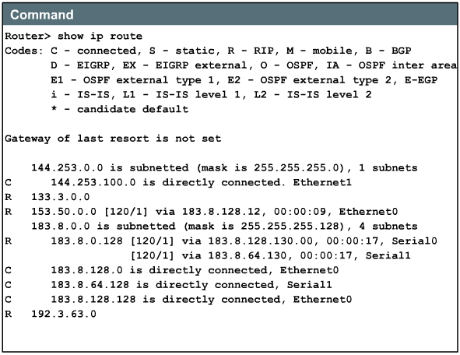
Verifying RIP configuration: SHOW IP ROUTE
Networks being advertised
Notes:
There are several commands that can be used to verify that RIP is properly configured. Two of the most common are the show ip route command and the show ip protocols command. The show ip protocols command shows which routing protocols are carrying IP traffic on the router. This output can be used to verify most if not all of the RIP configuration. Some of the most common configuration items to verify are:
RIP routing is configured
The correct interfaces are sending and receiving RIP updates
The router is advertising the correct networks
The show ip route command can be used to verify that routes received by RIP neighbors are installed in the routing table. Examine the output of the command and look for RIP routes signified by "R". Remember that the network will take some time to converge so the routes may not appear immediately.
Additional commands to check RIP configuration are as follows:
show interface interface
show ip interface interface
show running-config

Slide 25
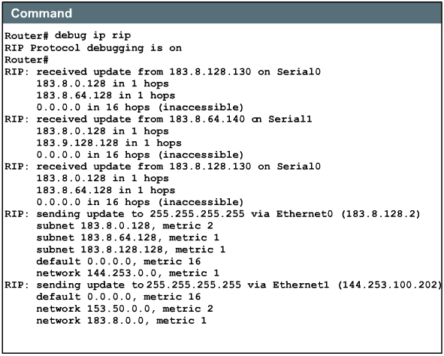
Troubleshooting RIP update issues: DEBUG IP RIP
Notes:
Most of the RIP configuration errors involve an incorrect network statement, discontiguous subnets, or split horizons. One highly effective command for finding RIP update issues is the debug ip rip command. The debug ip rip command displays RIP routing updates as they are sent and received. The example in Figure shows the output from a router using the debug ip rip command after receiving a RIP update. After receiving and processing the update, the router sends the newly updated information out its two RIP interfaces. The output shows the router is using RIP version 1 and broadcasts the update (broadcast address 255.255.255.255). The number in parenthesis represents the source address encapsulated into the IP header of the RIP update.
There are several key indicators to look for in the output of the debug ip rip command. Problems such as discontiguous subnetworks or duplicate networks can be diagnosed with this command. A symptom of these issues would be a router advertising a route with a metric that is less than the metric it received for that network.
Other commands to troubleshoot RIP:
show ip rip database
show ip protocols {summary}
show ip route
debug ip rip {events}
show ip interface brief

Slide 26
Troubleshooting RIP update issues: Others command
show ip rip database
show ip protocols {summary}
show ip route
debug ip rip {events}
show ip interface brief

Slide 27
Load balancing with RIP
1
56K
64K
2
GAD
1.544M
BHM
3
155M
4
RIP is capable of load balancing over as many as six equal-cost paths, with four paths being default. RIP performs what is referred to as “round robin” load balancing.
Router(config-router)#maximum-paths [number]
Notes:
Load balancing is a concept that allows a router to take advantage of multiple best paths to a given destination. These paths are either statically defined by a network administrator or calculated by a dynamic routing protocol such as RIP. RIP is capable of load balancing over as many as six equal-cost paths, with four paths being default. RIP performs what is referred to as “round robin” load balancing. This means that RIP takes turns forwarding packets over the parallel paths.
Figure shows an example of RIP routes with four equal cost paths. The router will start with an interface pointer to the interface connected to router 1. Then the interface pointer cycles through the interfaces and routes in a deterministic fashion such as 1-2-3-4-1-2-3-4-1 and so on. Because the metric for RIP is hop count, no regard is given to the speed of the links. Therefore, the 56 Kbps path will be given the same preference as the 155 Mbps path.
The range of maximum paths is one to six paths. To change the maximum number of parallel paths allowed, use the following command in router configuration mode:
Router(config-router)#maximum-paths [number]

Slide 28
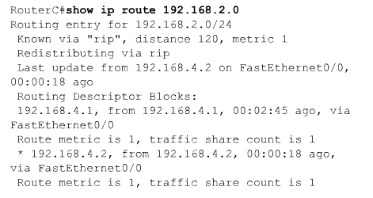
Load balancing with RIP
Notes:
Equal cost routes can be found by using the show ip route command. For example, Figure is a display of the output show ip route to a particular subnet with multiple routes.
Notice there are two routing descriptor blocks. Each block is one route. There is also an asterisk (*) next to one of the block entries. This corresponds to the active route that is used for new traffic.

Slide 29
Integrating static routes with RIP
Static routes are user-defined routes.
They are also useful for specifying a “gateway of last resort”, commonly referred to as a default route.
  A router running RIP can receive a default route via an update from another router running RIP.
  Another option is for the router to generate the default route itself.
RIP will advertise a static route throughout the internetwork.
  If static route is assigned to an interface that is defined in the RIP process, via a network command.
  Other, via a redistribute static command is specified in the RIP process.
Notes:
Static routes are user-defined routes that force packets moving between a source and a destination to take a specific path. Static routes become very important if the Cisco IOS software does not learn a route to a particular destination. They are also useful for specifying a “gateway of last resort”, commonly referred to as a default route. If a packet is destined for a subnet that is not explicitly listed in the routing table, the packet is forwarded to the default route. A router running RIP can receive a default route via an update from another router running RIP. Another option is for the router to generate the default route itself.
Static routes that point out an interface will be advertised via the RIP router that owns the static route, and propagated throughout the internetwork. This is because static routes that point to an interface are considered in the routing table to be connected and thus lose their static nature in the update. If a static route is assigned to an interface that is not defined in the RIP process, via a network command, RIP will not advertise the route unless a redistribute static command is specified in the RIP process.

Slide 30
RIP with floating route
.2
192.168.13.0/30
.1
BHM
S0/0
.2
GAD
Bri0/1
192.168.14.0/30
.1
The floating static route was configured by defining an AD on the static route (130) greater than the default AD of RIP (120).
Notes:
The static routes can be removed using the no ip route global configuration command. The administrator can override a static route with dynamic routing information by adjusting the administrative distance values. Each dynamic routing protocol has a default administrative distance (AD). A static route can be defined as less desirable than a dynamically learned route, as long as the AD of the static route is higher than that of the dynamic route.
When an interface goes down, all static routes pointing out that interface are removed from the IP routing table. Likewise, when the software can no longer find a valid next hop for the address specified in the static route, then the static route is removed from the IP routing table.
In Figure a static route has been configured on the GAD router to take the place of the RIP route in the event that the RIP routing process fails. This is referred to as a floating static route. The floating static route was configured by defining an AD on the static route (130) greater than the default AD of RIP (120). The BHM router would also need to be configured with a default route.

Slide 31

IGRP
INTERIOR GATEWAY ROUTING PROTOCOL

Slide 32
Characteristics
Cisco’s Distance-vector routing protocol.
Routing updates at 90 second intervals, advertising networks for a particular AS.
The versatility to automatically handle indefinite, complex topologies
The flexibility needed to segment with different bandwidth and delay characteristics
Scalability for functioning in very large networks.
Use a composite metric of bandwidth, delay, load and reliability.
Notes:
IGRP is a distance vector Interior Gateway Protocol (IGP). Distance vector routing protocols mathematically compare routes by measuring distances. This measurement is known as the distance vector. Routers using distance vector protocols must send all or a portion of their routing table in a routing update message at regular intervals to each of their neighboring routers. As routing information spreads throughout the network, routers perform the following functions:
Identify new destinations
Learn of failures
IGRP is a distance vector routing protocol developed by Cisco. IGRP sends routing updates at 90 second intervals, advertising networks for a particular autonomous system. Key design characteristics of IGRP are a follows:
The versatility to automatically handle indefinite, complex topologies
The flexibility needed to segment with different bandwidth and delay characteristics
Scalability for functioning in very large networks
IGRP can be configured to use a combination of variables to determine a composite metric. Those variables include:
The metrics that IGRP uses are:
Bandwidth – The lowest bandwidth value in the path
Delay – The cumulative interface delay along the path
Reliability – The reliability on the link towards the destination as determined by the exchange of keepalives
Load – The load on a link towards the destination based on bits per second
MTU – The Maximum Transmission Unit value of the path.
By default, the IGRP routing protocol uses bandwidth and delay as metrics.

Slide 33
IGRP Metric
k₂xBW
Metric =
k₁xBW +
+ k₃xDelay
256 – Load
k₅
If k₅ ≠ 0 then: Metric = Metric x
Rel + k₄
Default: k₁ = 1, k₂ = 0, k₃ = 1, k₄ = 0, k₅ = 0.
Delay is the sum of all the delays of all outgoing interfaces divided by 10.
  Delay = [Delay / 10ms].
BW is the lowest bandwidth of all outgoing interfaces divided by 10,000,000.
  BW = [10.000.000 / bandwidth in Kbps].

Slide 34
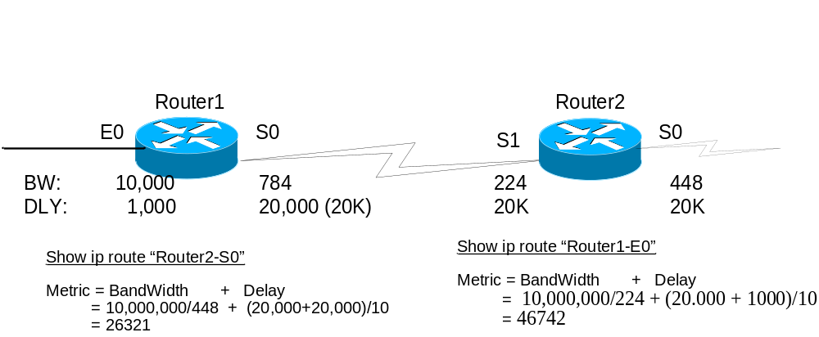
Example: IGRP Metric

Slide 35
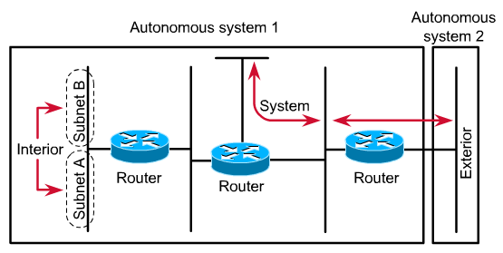
Interior, System and Exterior route
Notes:
IGRP advertises three types of routes:
Interior
System
Exterior
Interior
Interior routes are routes between subnets of a network attached to a router interface. If the network attached to a router is not subnetted, IGRP does not advertise interior routes.
System
System routes are routes to networks within an autonomous system. The Cisco IOS software derives system routes from directly connected network interfaces and system route information provided by other IGRP-speaking routers or access servers. System routes do not include subnet information.
Exterior
Exterior routes are routes to networks outside the autonomous system that are considered when identifying a gateway of last resort. The Cisco IOS software chooses a gateway of last resort from the list of exterior routes that IGRP provides. The software uses the gateway (router) of last resort if a better route is not found and the destination is not a connected network. If the autonomous system has more than one connection to an external network, different routers can choose different exterior routers as the gateway of last resort.

Slide 36
IGRP stability features
IGRP has a number of features that are designed to enhance its stability, such as:
  Holddowns
  Split horizons
  Poison reverse updates
IGRP also maintains a number of timers and variables containing time intervals. These include an update timer, an invalid timer, a holddown timer, and a flush timer.
Notes:
IGRP has a number of features that are designed to enhance its stability, such as:
Holddowns
Split horizons
Poison reverse updates
Holddowns
Holddowns are used to prevent regular update messages from inappropriately reinstating a route that may not be up. When a router goes down, neighboring routers detect this via the lack of regularly scheduled update messages.
Split horizons
Split horizons are derived from the premise that it is usually not useful to send information about a route back in the direction from which it came. The split horizon rule helps prevent routing loops.
Poison reverse updates
Split horizons prevent routing loops between adjacent routers, but poison reverse updates are necessary to defeat larger routing loops. Generally speaking, increases in routing metrics indicate routing loops. Poison reverse updates then are sent to remove the route and place it in holddown. With IGRP, poison reverse updates are sent only if a route metric has increased by a factor of 1.1 or greater.
IGRP also maintains a number of timers and variables containing time intervals. These include an update timer, an invalid timer, a holddown timer, and a flush timer.
The update timer specifies how frequently routing update messages should be sent. The IGRP default for this variable is 90 seconds.
The invalid timer specifies how long a router should wait in the absence of routing-update messages about a specific route before declaring that route invalid. The IGRP default for this variable is three times the update period.
The holddown timer specifies the amount of time for which information about poorer routes is ignored. The IGRP default for this variable is three times the update timer period plus 10 seconds.
Finally, the flush timer indicates how much time should pass before a route is flushed from the routing table. The IGRP default is seven times the routing update timer.
Today, IGRP is showing its age, it lacks support for variable length subnet masks (VLSM). Rather than develop an IGRP version 2 to correct this problem, Cisco has built upon IGRP's legacy of success with Enhanced IGRP.

Slide 37
Configuring IGRP and migrating RIP to IGRP
Ethernet
Ethernet
F0/0
S0/1
S0/0
S0/0
F0/0
BHM
GAD
BOAZ
10.0.0.254
192.168.13.1
192.168.13.2
192.168.14.2
192.168.14.2
172.31.31.1
BHM(config)#router igrp 101
BHM(config-router)#network 10.0.0.0 BHM(config-router)#network 192.168.13.0
Selects igrp as the routing protocol
101 is Autonomous System number is one that identifies the IGRP process.
GAD(config)#router igrp 101
GAD(config-router)#network 192.168.14.0 GAD(config-router)#network 192.168.13.0
Specifies a directly connected network
Major netwotk not subbnetwork
BOAZ(config)#router igrp 101
BOAZ(config-router)#network 192.168.14.0 BOAZ(config-router)#network 172.31.0.0
BHM(config)# no router igrp 101
Notes:
To configure the IGRP routing process, use the router igrp configuration command. To shut down an IGRP routing process, use the no form of this command.
RouterA(config)#router igrp as-number
RouterA(config)#no router igrp as-number
The Autonomous System number is one that identifies the IGRP process. It is also used to tag the routing information.
To specify a list of networks for IGRP routing processes, use the network router configuration command. To remove an entry, use the no form of the command.
With the creation of IGRP in the early 1980s, Cisco Systems was the first company to solve the problems associated with using RIP to route datagrams between interior routers. IGRP determines the best path through the internetwork by examining the bandwidth and delay of the networks between routers. IGRP converges faster than RIP, thereby avoiding the routing loops caused by disagreement over the next routing hop to be taken. Further, IGRP does not share the hop count limitation of RIP. As a result of this and other improvements over RIP, IGRP enabled many large, complex, topologically diverse internetworks to be deployed. These are the steps to follow to convert from RIP to IGRP.
Verify existing routing protocol (RIP) on the routers to be converted.
Configure IGRP on RouterA and RouterB
Enter show ip protocols on RouterA and RouterB
Enter show ip route on RouterA and RouterB

Slide 38
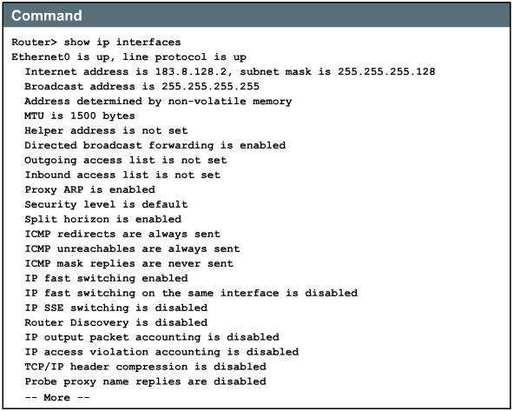
Verifying IGRP configuration: SHOW IP INTERFACES
Notes:
To verify that IGRP has been configured properly, enter the show ip route command and look for IGRP routes signified by an "I". Additional commands for checking IGRP configuration are as follows:
show interface interface
show running-config
show running-config interface interface
show running-config | begin interface interface
show running-config | begin igrp
show ip protocols
To verify that the Ethernet interface is properly configured, enter the show interface fa0/0 command. Figure illustrates the output.
To see if IGRP is enabled on the router, enter the show ip protocols command

Slide 39
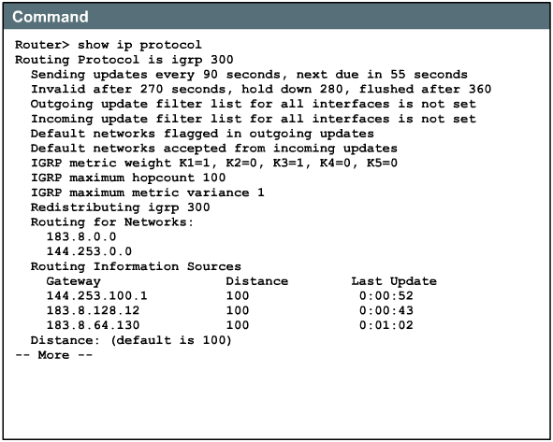
Verifying IGRP configuration: SHOW IP PROTOCOLS

Slide 40
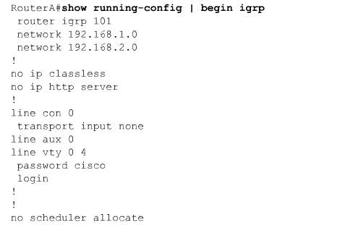
Verifying IGRP configuration: SHOW RUN

Slide 41
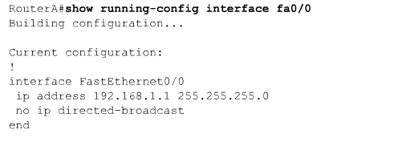
Verifying IGRP configuration: SHOW RUN

Slide 42
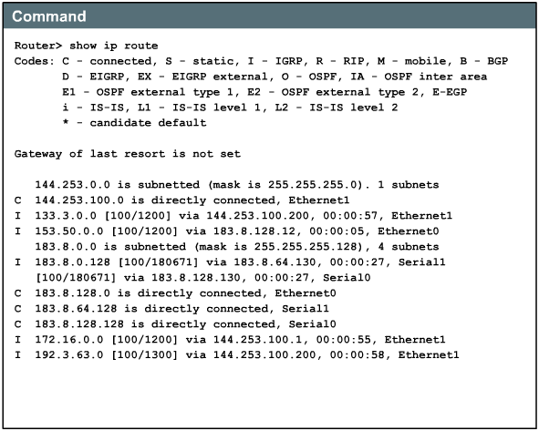
Verifying IGRP configuration: SHOW IP ROUTE

Slide 43
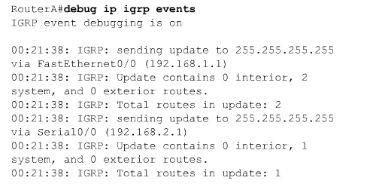
Troubleshooting IGRP
Notes:
Most IGRP configuration errors involve a mistyped network statement, discontiguous subnets, or an incorrect Autonomous System Number. The following commands are useful when troubleshooting IGRP:
show ip protocols
show ip route
debug ip igrp events
debug ip igrp transactions
ping
traceroute

Slide 44
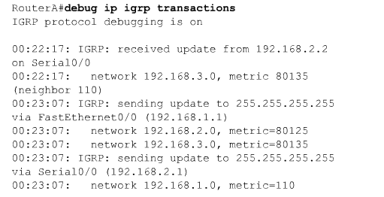
Troubleshooting IGRP

Slide 45

Summary
Routing table updates occur periodically, when yhe topology in a distance vector protocol network changes.
RIP is a distance vector routing protocol.
RIP has evolved over the years from classful routing protocol, RIP Version 1 (RIP v1), to a classless routing protocol, RIP Version 2 (RIP v2).
IGRP is a distance vector routing protocol developed by Cisco.

Slide 46

Q&A
Notes:
_________________________________________________________________________
_________________________________________________________________________
_________________________________________________________________________
_________________________________________________________________________
_________________________________________________________________________
_________________________________________________________________________
_________________________________________________________________________
_________________________________________________________________________
_________________________________________________________________________
_________________________________________________________________________
_________________________________________________________________________
_________________________________________________________________________
_________________________________________________________________________
_________________________________________________________________________
_________________________________________________________________________
_________________________________________________________________________
_________________________________________________________________________
_________________________________________________________________________
_________________________________________________________________________

Slide 47
Enjoy the Course
Notes:
_________________________________________________________________________
_________________________________________________________________________
_________________________________________________________________________
_________________________________________________________________________
_________________________________________________________________________
_________________________________________________________________________
_________________________________________________________________________
_________________________________________________________________________
_________________________________________________________________________
_________________________________________________________________________
_________________________________________________________________________
_________________________________________________________________________
_________________________________________________________________________
_________________________________________________________________________
_________________________________________________________________________
_________________________________________________________________________
_________________________________________________________________________
_________________________________________________________________________
_________________________________________________________________________

